Slide 1
Study session instructions
1
Please wait for the researcher to begin the instruction phase . . .

Slide 2
Study session
2
This study has two main components:
Video switching task
Questionnaire survey
We will now describe what you need to do on the video switching task.

Slide 3
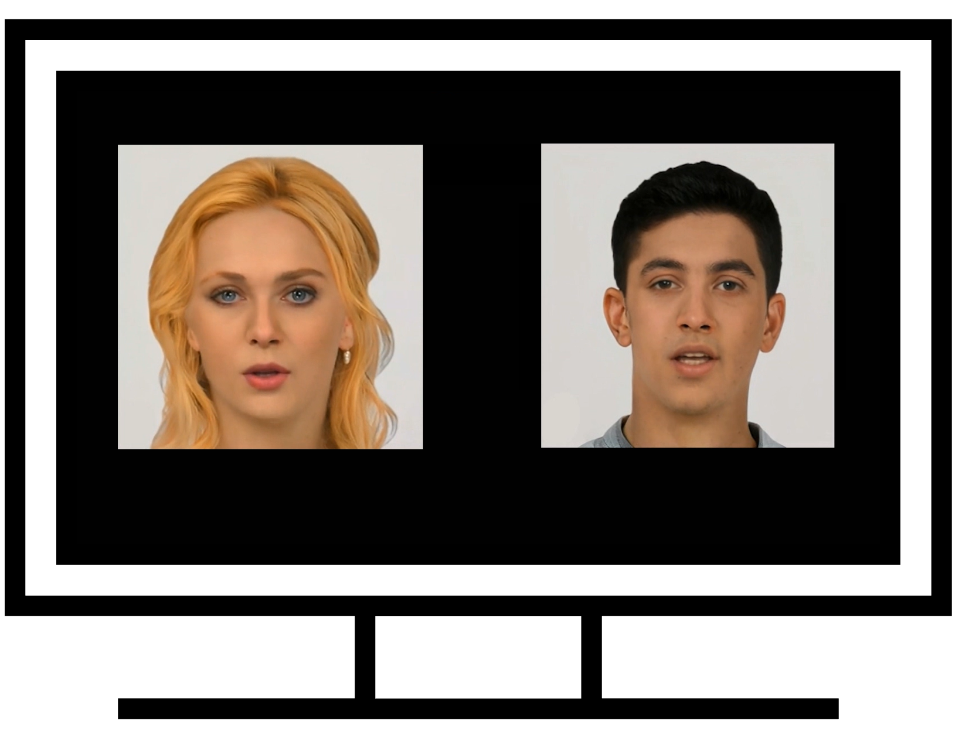
Video switching task - Instructions
3
During this task you will see pairs of videos playing on the computer screen.
One video will be displayed on the left side of the screen and one on the right side of the screen.
The two videos will be playing at the same time.
This will look like the screen opposite.

Slide 4
Video switching task - Instruction
4
In each video pair, the heads talk about a topic that they have been thinking about.
There is no requirement to focus on any specific video. When the videos are playing simply let your attention do whatever it does naturally.
While the videos are playing, they will switch positions at random intervals. i.e., the left video will change to the right and the right video will change to the left.

Slide 5
Video switching task - Instruction
5
Frequently during the videos, a probe will appear. What we mean by the probe is a shape that flashes up very briefly. Probes look like a hashtag symbol but with one position in the hashtag filled in. You can see each possible probe below.
When there is a probe presentation, the probe appears simultaneously in the location of both videos.

Slide 6
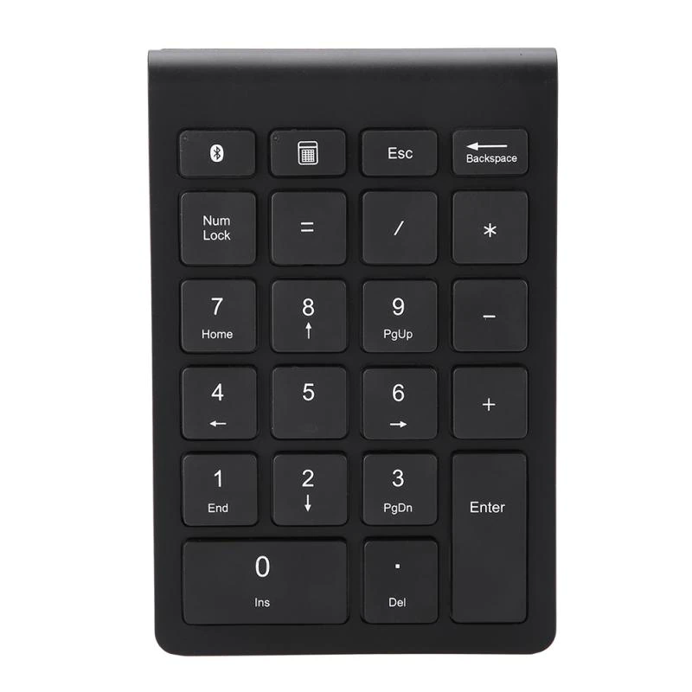
Video switching task - Instruction
6
Your goal in this task:
Whichever video you happen to be viewing, you will see the probe there. You need to use the number pad on the keyboard to press the corresponding number to the grey square in the probe.
Your response will be counted if you respond accurately to the probe within a 2 second interval after the probe appears.
If you are unsure of the identity of the probe, then press the response that is your best guess.
After responding to the probe, the videos continue playing until the next probe appears.

Slide 7
Study session
7
Before you start the study critical tasks, you will complete a short practice task to familiarize yourself with the procedure.
You will be provided the opportunity to take brief breaks in your seat during the task. The computer will tell you when you can take a break.
After the video task is completed, please let the researcher know.

Slide 8
Questions?
8
Please take this opportunity to ask the researcher any questions you have about these instructions.
If you have a question or problem at any point during the task, please notify the researcher.
Please notify the researcher immediately if you wish to withdraw from the study session.

Slide 9
Thank you 🙂
9
Thank you for listening to these instructions.
Please wait for the researcher to begin the practice task for you . . .

